Slide 1
Automobile Sales & Profit Analysis Dashboard
Compiled By- Ritik Bhardwaj

Slide 2
Introduction
This project analyzes key business metrics across the automobile dataset, focusing on sales, cost, profit, customer demographics, and vehicle trends.
Key areas analyzed:
• Revenue and profit performance
• Top-performing models and makes
• Geographic distribution of sales
• Spare parts and delivery charge insights

Slide 3
Methodology
1. Cleaned and transformed data in Power Query
2. Built DAX measures for KPIs: Total Sales, Total Profit, Margin %, Avg Price
3. Created multi‑page BI dashboards using advanced visualizations
4. Applied a clean pink & white theme for design consistency

Slide 4
Approach
• Identify profitability patterns by model and make
• Analyze geographic market strength
• Understand customer purchase trends
• Evaluate spare parts, delivery costs & pricing influence on profit
• Compare model performance using scatter and bar analysis

Slide 5
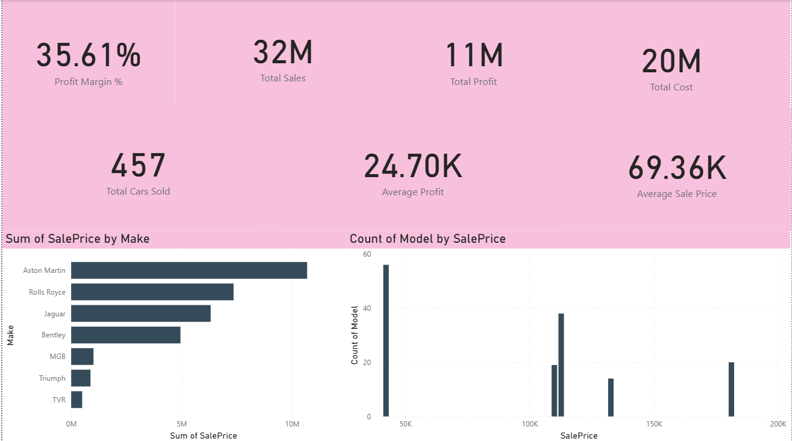
Dashboard Overview – Page 1

Slide 6
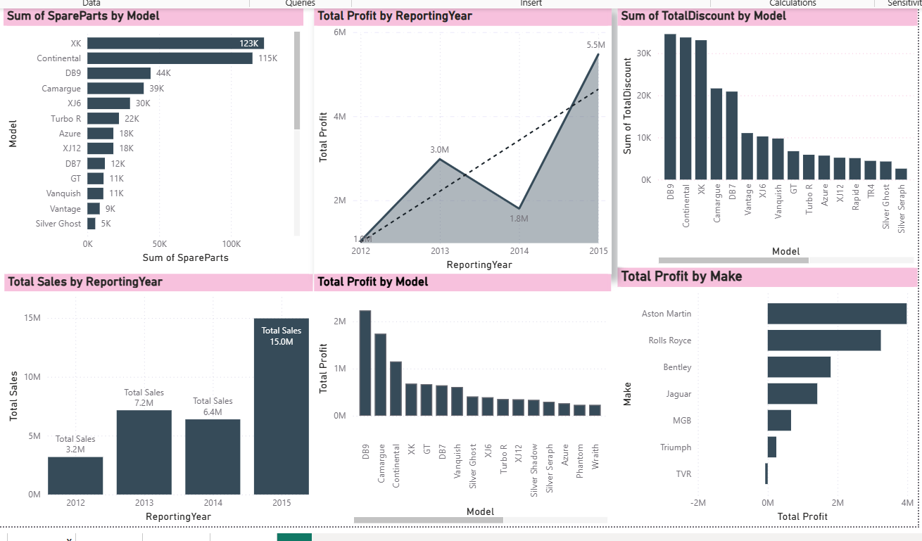
Dashboard Overview – Page 2

Slide 7
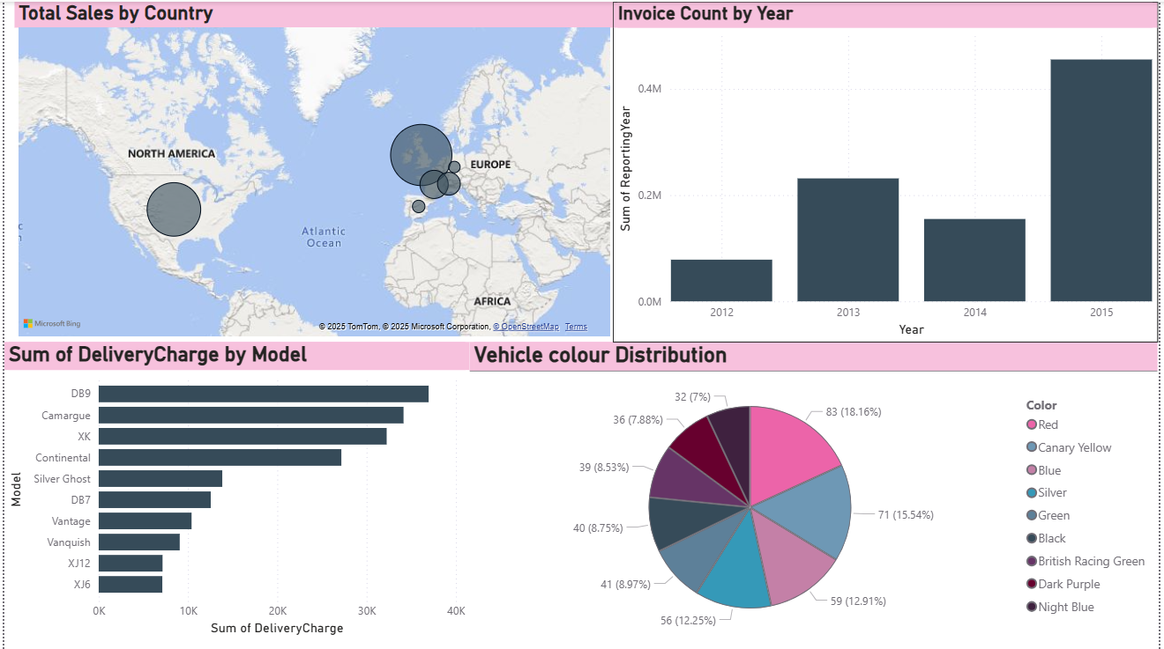
Dashboard Overview – Page 3

Slide 8
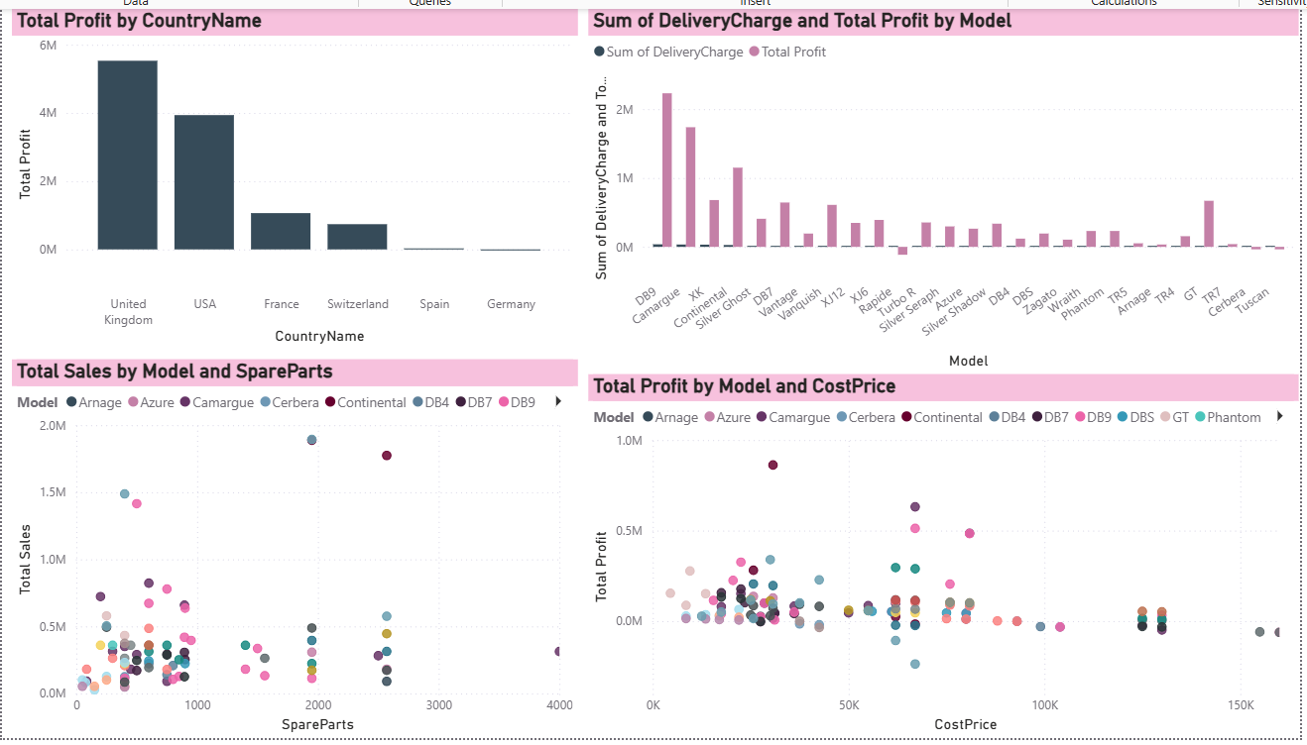
Dashboard Overview – Page 4

Slide 9
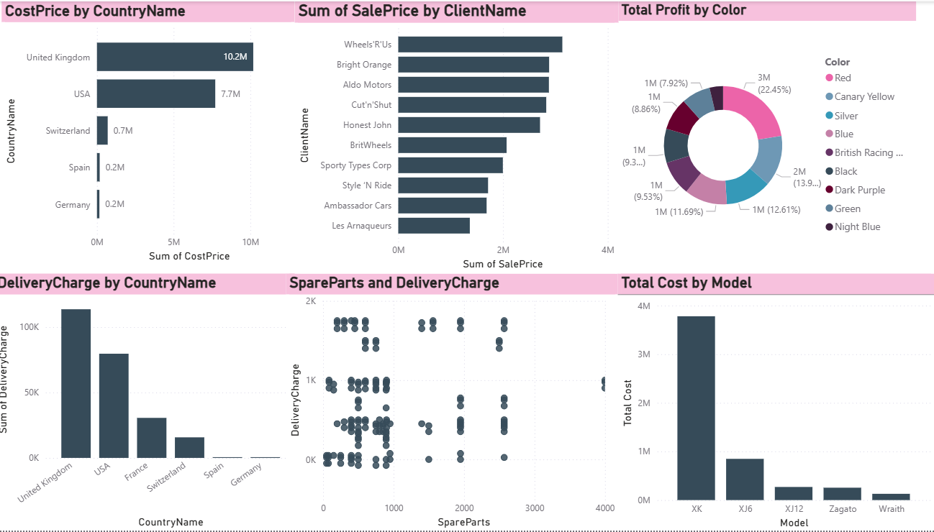
Dashboard Overview – Page 5

Slide 10
Key Findings
• Total Sales: 32M • Total Profit: 11M • Profit Margin: 35.61%
• Aston Martin, Rolls Royce are top contributors in SalePrice
• UK & USA generate highest revenue and profit
• High spare parts usage in DB9, Continental → strong after‑sales potential
• Peak performance year: 2015 with highest sales and invoices

Slide 11
Insights
• Premium models → high profit but low volume (luxury segment)
• Frequent spare parts demand models → after‑sales revenue opportunity
• Blue, Silver & Racing Green are top vehicle colors → inventory planning
• Delivery charges heavily impact certain markets → logistics optimization
• Cost vs Profit correlation shows stable profit band across high‑cost models

Slide 12
Actionable Recommendations
• Increase focus on high‑profit models (DB9, Continental, Aston Martin)
• Optimize delivery logistics for high‑cost regions (USA)
• Stock high‑demand vehicle colors to reduce delays
• Strengthen after‑sales services for models with high spare‑part usage
• Reassess pricing strategy for underperforming models

Slide 13
Conclusion
The BI dashboard provides a clear, data‑driven picture of the automobile business across sales, cost, profit, geography, and customer behavior.
These insights will help stakeholders:
• Improve profitability
• Optimize inventory
• Enhance customer targeting
• Streamline operations
This project demonstrates strong analytical and visualization skills using Power BI.

